Slide 1
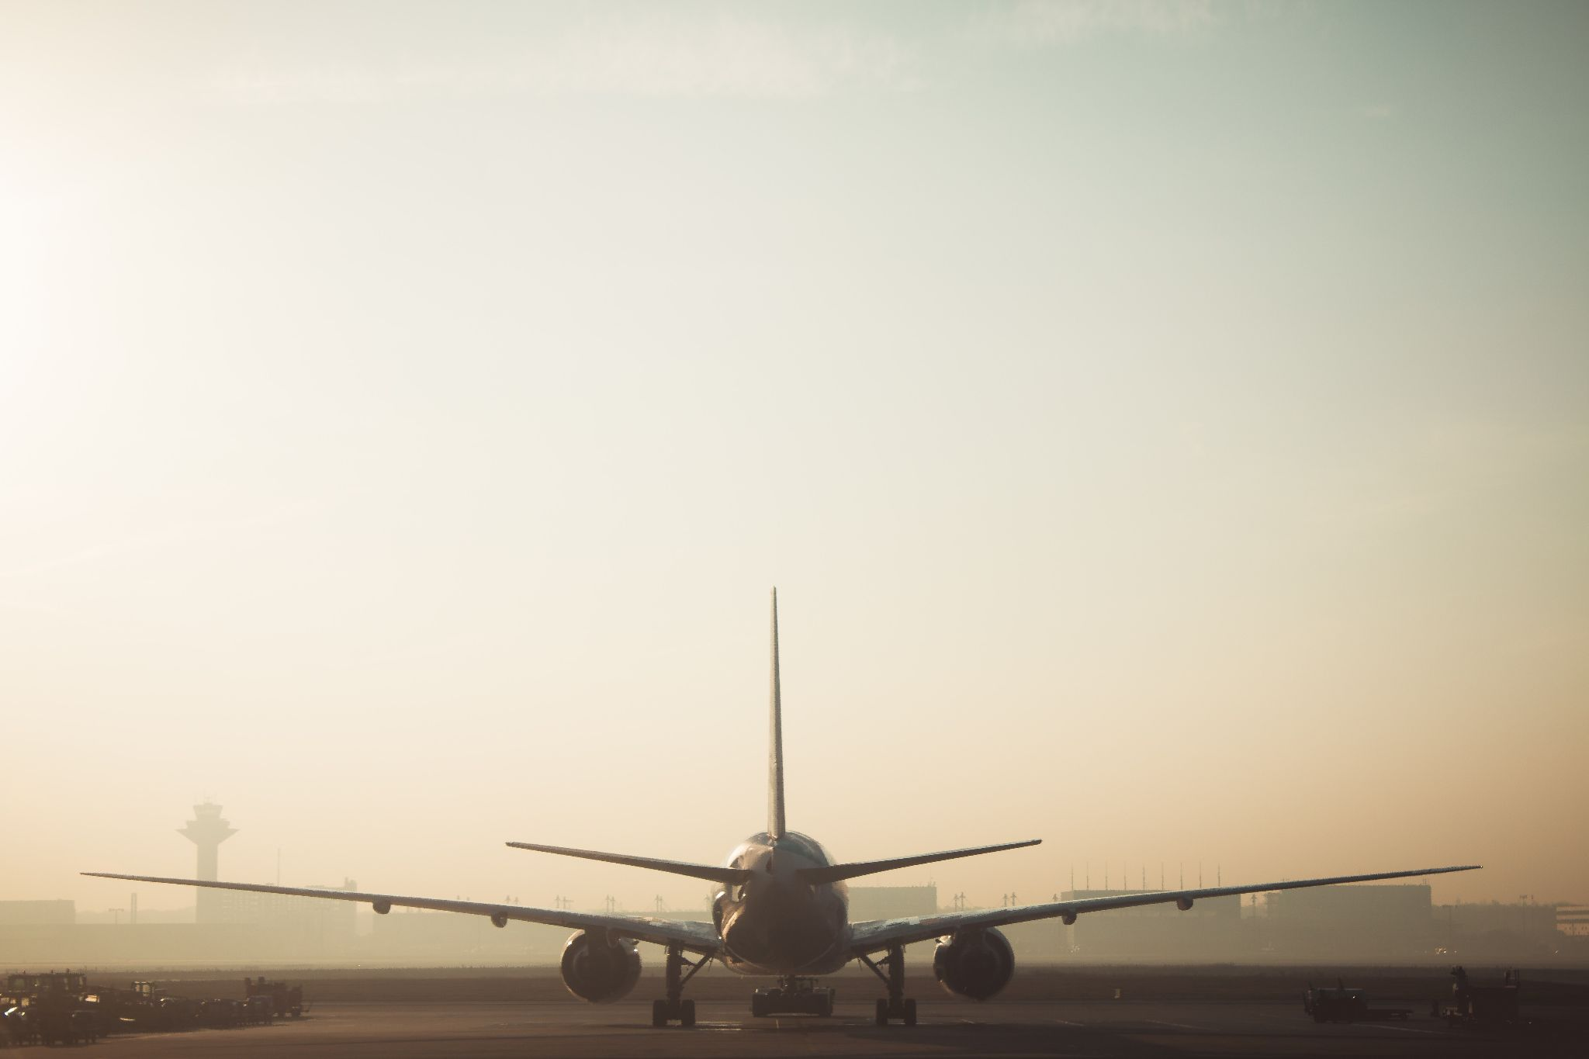
Ugh! Flight Delays:
Taking Off Late
Looking at Domestic Departure Delays from NYC Airports between 2019-2022
Timothy Yip
Notes:
Hello I am Timothy Yip, Data Analyst and Aviation Geek. I have always been fascinated by aviation as a young child, living under the LaGuardia flight path and going on my first flight on American Airlines to Puerto Rico when I was 4 years old. Today we will be looking at domestic departure flight delays at the 3 NYC airports between 2019 to 2022

Slide 2




About Me
Timothy Yip
Data Analyst Fellow with
Aviation Geek
https://www.linkedin.com/in/timsyip/
timsyip@gmail.com

Slide 3
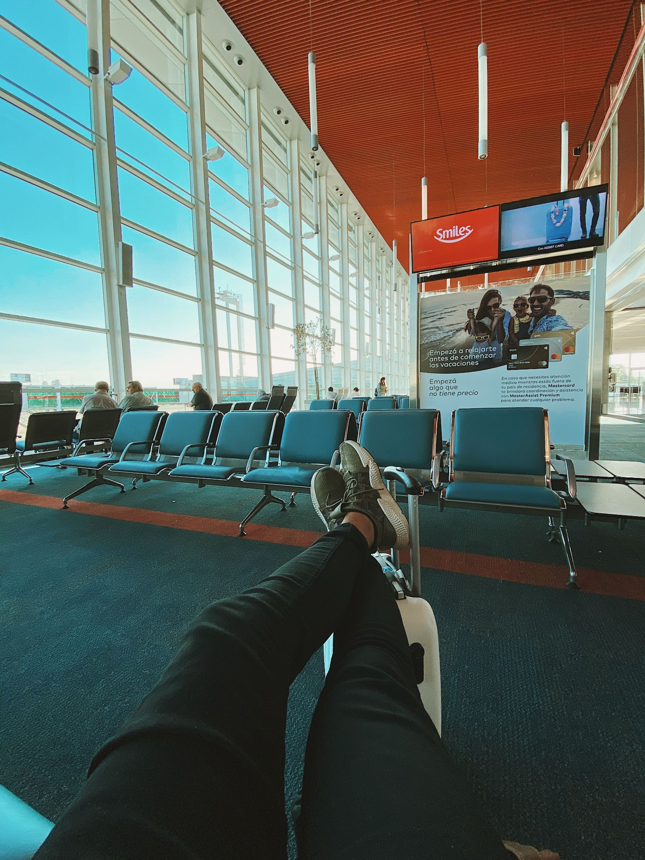
Intro
New York City airports consistently rank in the top 10 across the country for most delays. ¹
New York metropolitan area is the busiest airspace in the United States with the 3 major airports, 4 other commercial airports, many more general aviation airports and heliports. ²
Covid-19 severely impacted the airline industry.³
In 2022, we saw huge delays and cancellation of flights.
Notes:
Have you ever gotten to the airport excited for your trip to somewhere but then you look at the flightboard it says your flight was delayed?
Delays are inevitable whether it is weather, mechanical or something else.
At the beginning of 2022, hundreds of U.S. flights cancelled in the wake of winter storms and as the fast-spreading Covid omicron variant that affected flight crews.
Throughout 2022 weather and air traffic control, staffing and increased Covid case rates contributed to higher-than-planned unscheduled absences.
At the end of 2022 Southwest Airlines cancelled and delayed majority of their flights due to severe weather and staff absences. Southwest initiated a systemwide reset causing to cancel and delay even more flights.

Slide 4
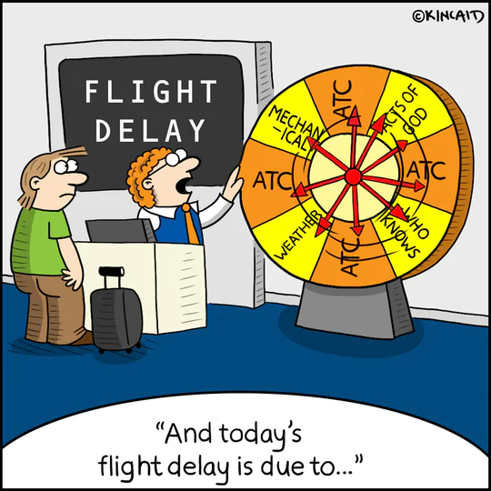
Data Questions
How has Covid affected the airline industry? Has the airline industry recovered?
What time of the year has the longest average delays?
Which airlines and airports have the longest delays?
What time of day is the best time to fly?
How have delays changed over time?
What is the likelihood of an airline delaying your flight?
Notes:
I plan to answer these questions in my presentation.

Slide 5



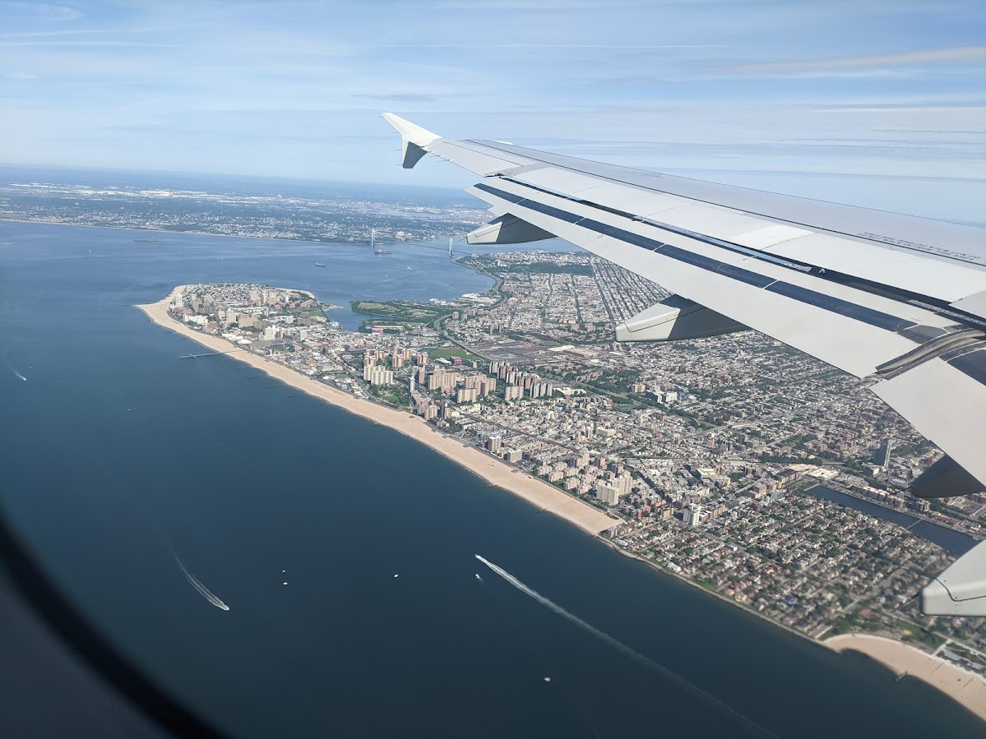
Research
Tools Used:
Flight Status Prediction(Kaggle)
United States Department of Transportation Bureau of Transportation Statistics
Excel
Python
Tableau
Notes:
I found my dataset on Kaggle and supplemented additional information from the US Department of Transportation. I used Excel and Python to clean the data and use tableau to create the visualization.

Slide 6










Domestic Airlines that fly out of NYC Airports
Notes:
These are the major airlines that fly out of the NYC airports.

Slide 7










Airlines with Regional Airline Partners
Notes:
Many mainline airlines partner with regional airlines to serve smaller communities that lack the demand or infrastructure to support mainline flights.
Regional airlines often have codeshare agreements with major airlines, allowing them to offer passengers connecting flights to larger hubs and a wider range of destinations.

Slide 8
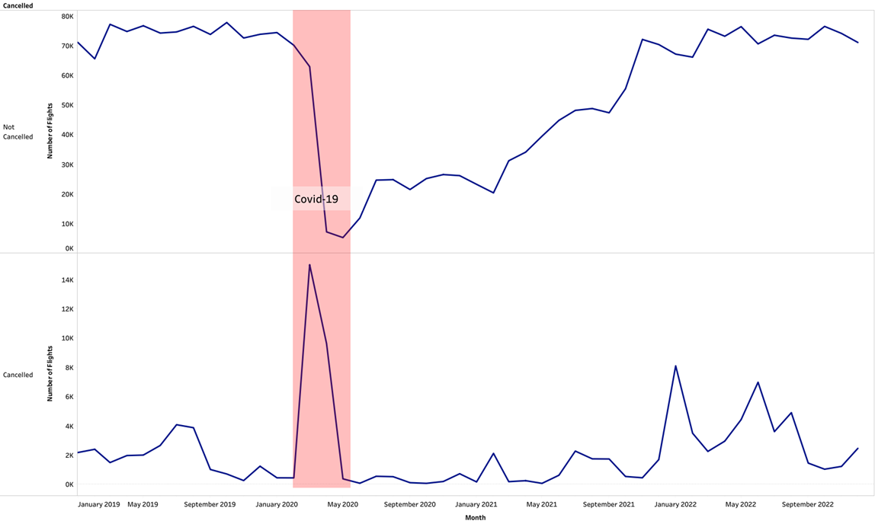
How has Covid affected the airline industry?
Number of Flights
October 2019 : 78,048
May 2020: 5,186
November 2022: 76,398
Number of Cancelled Flights:
March 2020 : 15,044
January 2022: 8,084
June 2022: 6,964
Notes:
In this you see that in Oct 2019 NYC airport had a peak of 78,000 flights. Flights were cancelled during the height of covid resulting a drop in flights during the beginning of Covid. As flights were being cancelled during covid crew members were being furloughed or took early retirement

Slide 9
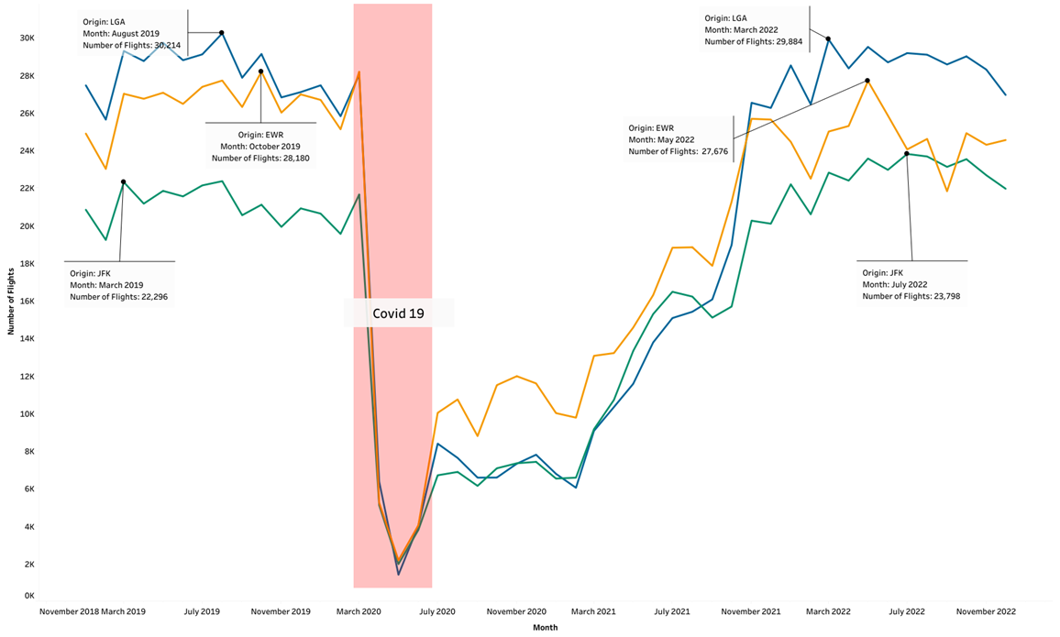
Has the airline industry recovered from Covid?
Notes:
In 2022 flights have rebounded close to 2019 numbers at the 3 airports

Slide 10
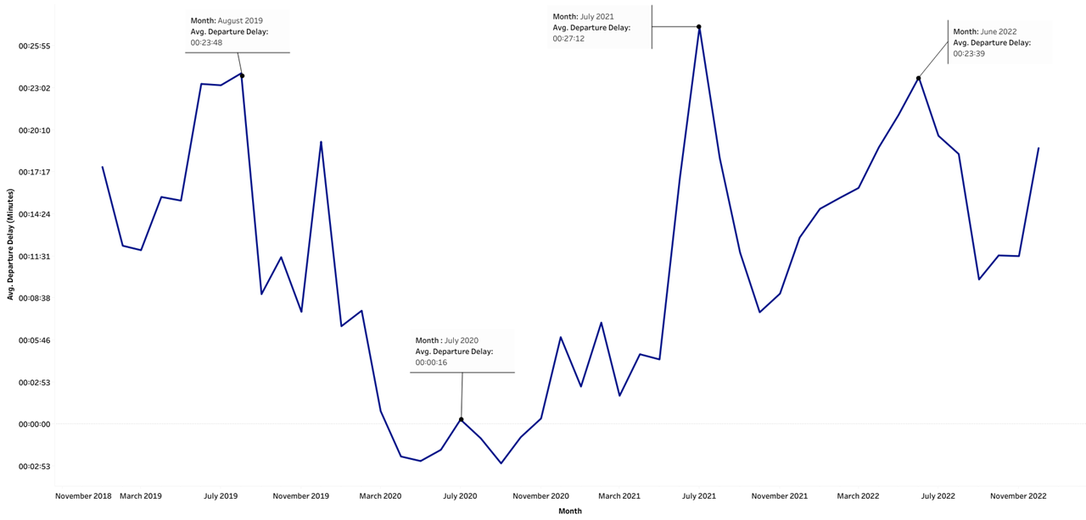
What time of the year has longest average delays?
Notes:
Expect longer delays during the summer months compared to the rest of the year
For 2019, 2021, and 2022 there was an average delay of 21 min
While 2020 had an avg of a 2 min delay

Slide 11
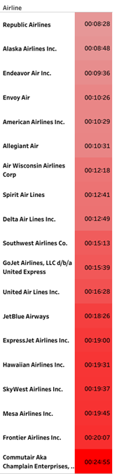
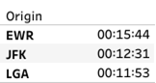
Which airlines and airport have the longest delays?
Longest Delays:
Airport: Newark
Airline: Commutair Airline (United) (25mins)
Shortest Delays:
Airport: Laguardia
Airlines: Republic Airlines(United, Delta, American)(8:30mins)

Slide 12
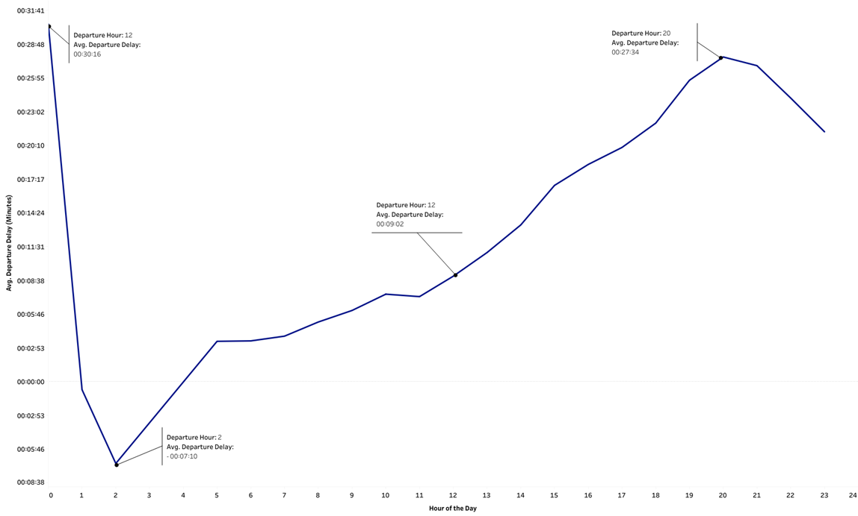
What time of day is the best time to fly?
Notes:
The best time to fly during the day is in the early morning compared to the evening. Flights later in the day have a greater chance of delays due to weather, maintenance and delays getting in and out of gates, which pushes back the entire flight schedule day. So there is always much more higher chance that an evening flight will be delayed. Planes don’t often fly at night, it means any technical issues will have been resolved by the engineers overnight.

Slide 13
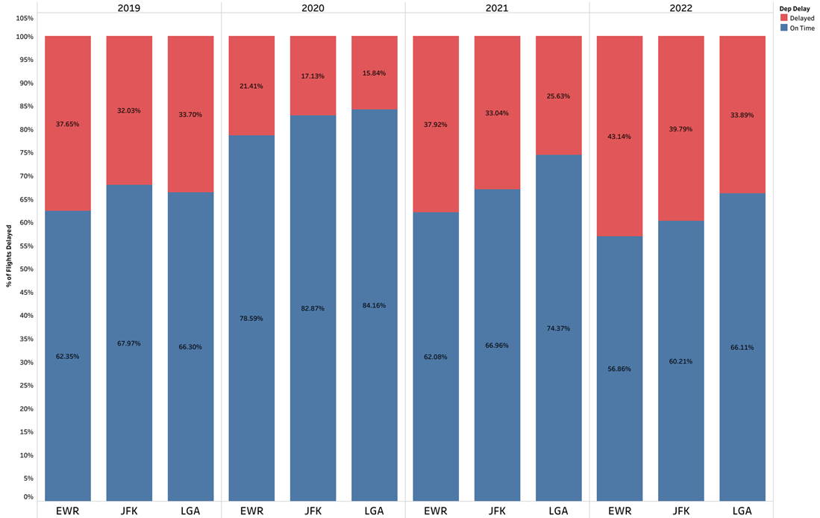
How have delays changed over time?
Notes:
Delays over all have gotten worse over time. According to government research majority of the delays are airline related.

Slide 14
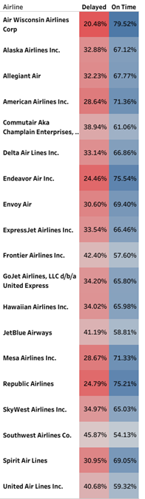
What is the likelihood of an airline delaying your flight?
High chance of a flight delay:
Southwest Airlines(46%)
Frontier Airlines(42%)
Jetblue Airlines(41%)
High chance of an on time departure:
Air Wisconsin(United) (79%)
Endeavor Air (American)(76%)
Republic Air (United, Delta, American)(75%)

Slide 15
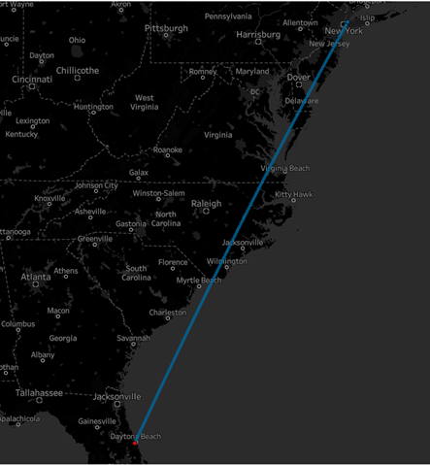
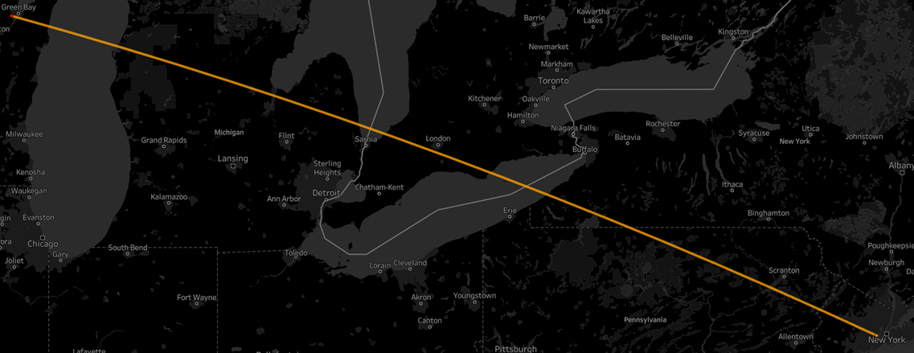
What are the best and worst destination for delays?
Most Delayed Flight:
United Airlines
Newark to Green Bay
Average Delay : 1:19:00
Early Departure:
Republic Airlines
LaGuardia to Daytona Beach
Early Departure: 5 Min

Slide 16
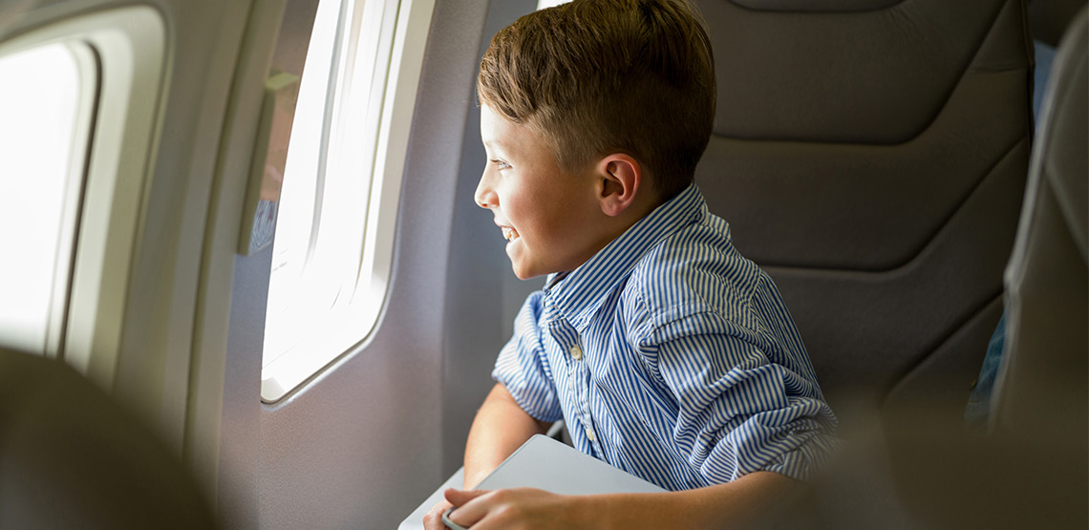
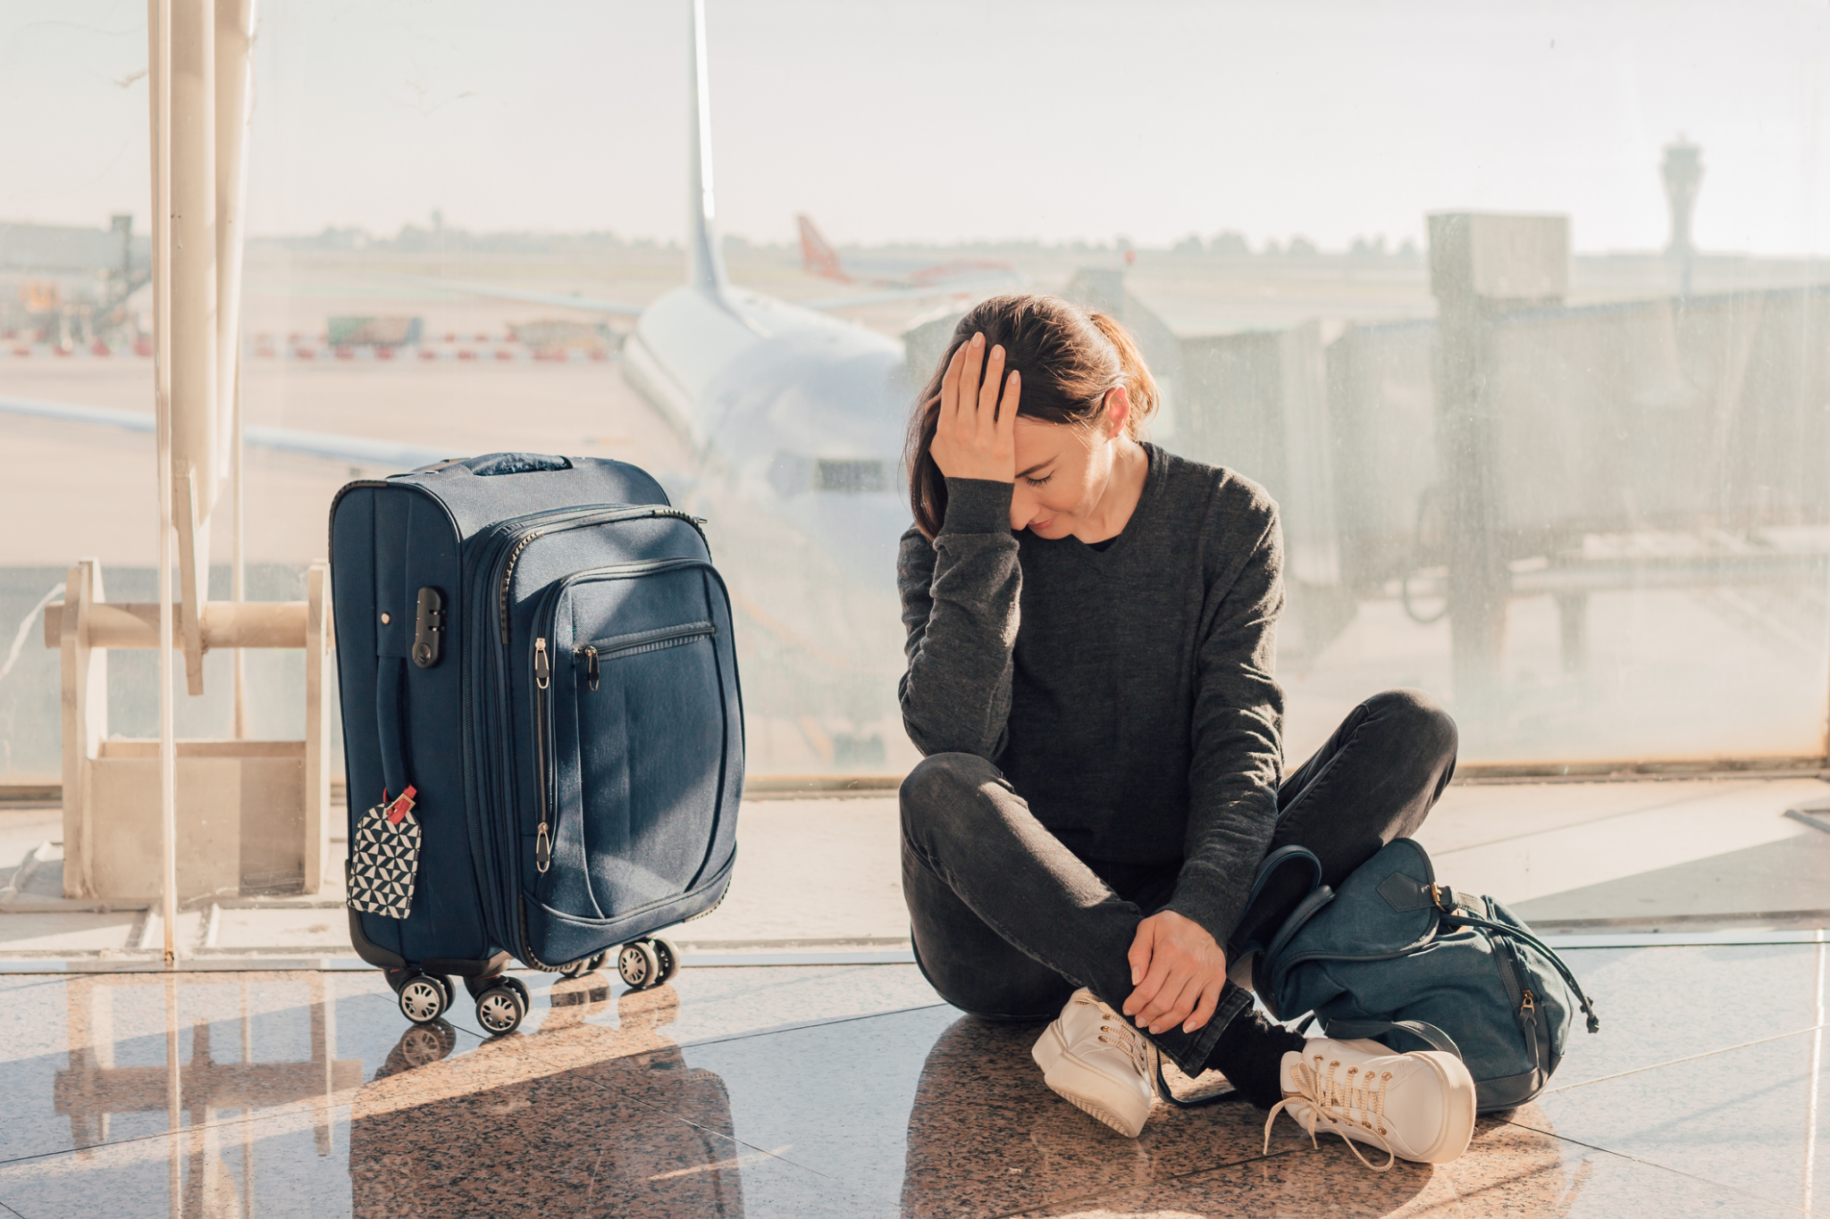
Conclusion
Happy Traveler
Fly outside the summer months
Takes an early morning flight
Fly out of LaGuardia
Fly Air Wisconsin(United)
Frustrated Traveler
Fly during the summer months
Take an evening flights
Fly out of Newark
Fly Southwest Airline
Notes:
If you want to be a Happy Traveler
You will be a frustrated if you

Slide 17
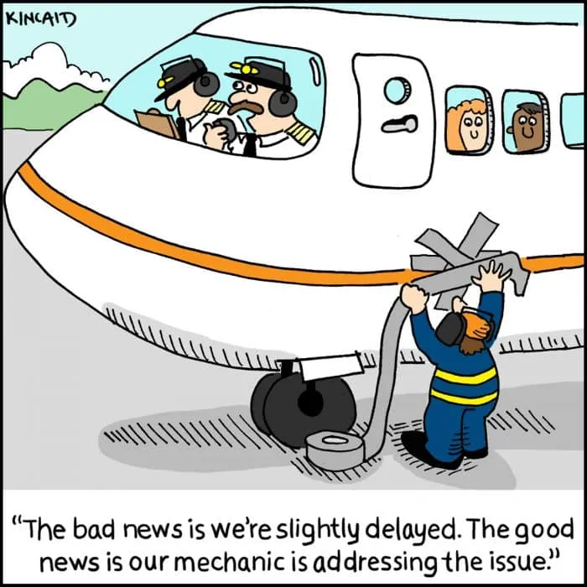
Next Steps
Analyze the reasons for the delays
Looking at arrival flight delays for the NYC airports
Analyze other large metropolitan area airport delays
ie Los Angeles or Chicago
On May 8, 2023, Biden administration proposed a rule that would seek airlines to compensate passengers for flight delays and cancellation. If this passes how will this have an effect of the flight delays and cancellation in the future? ⁴
Federal Aviation Administration(FAA) announced that it is asking airlines to cut services to the New York Area. How will this affect summer 2023 air travel in from the NYC airport? ⁵ ⁶
Notes:
FAA is asking airlines to cut serviced to the NYC airports during the summer because of the lack of air traffic controller, shortage of pilots and maintenance workers.

Slide 18
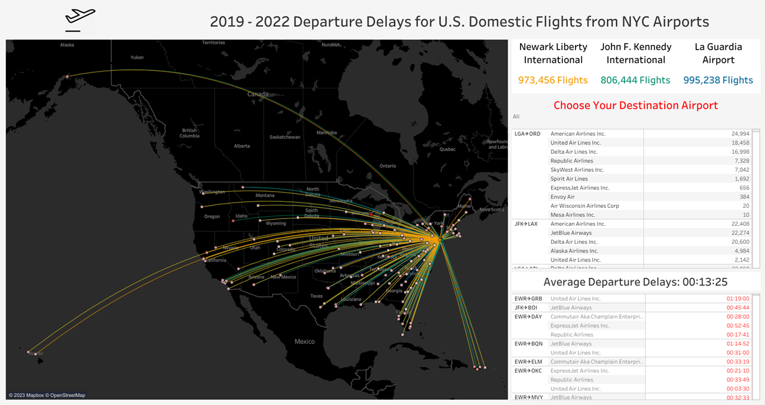
Dashboard
https://bit.ly/NYCDepDelay

Slide 19
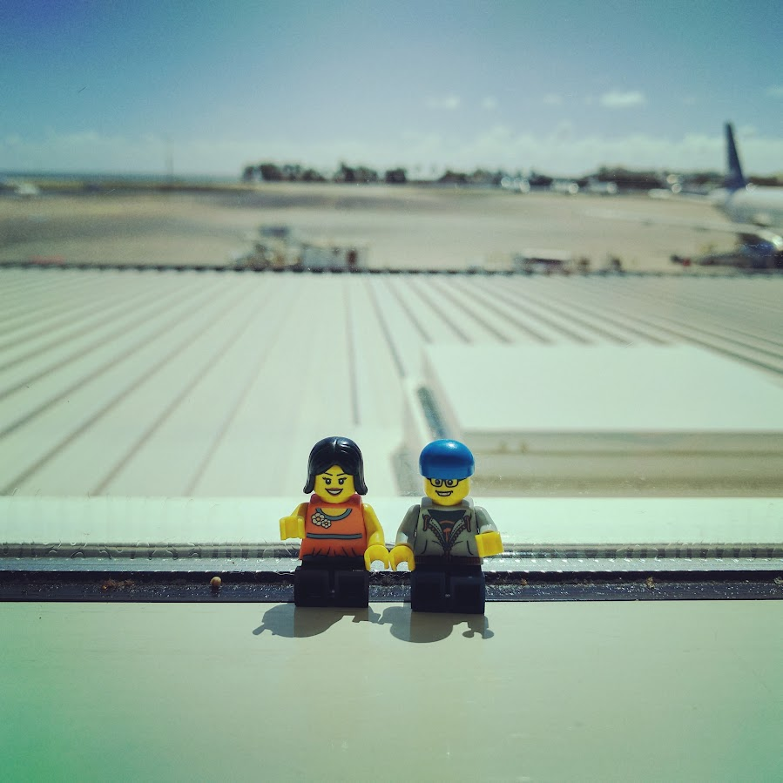
Sources
¹The Worst Airports in the World for Flight Delays and Cancellations
² Newark Airport just set two records. One stinks for travelers. - nj.com
³ Airlines cancel another 1,400 flights as omicron, severe weather continue to snarl travel
⁴ Biden Seeks Compensation for Passengers for Flight Delays and Cancellations - The New York Times
⁵ Delta CEO predicts 'record' summer travel season as FAA warns of another spike in delays
⁶ The FAA is warning flyers of a 45% increase in flight delays this summer in NYC and DC as it deals with staff shortage

Slide 20
Thank You!
NYC Tech Talent Pipeline
Fullstack Academy and Staff
Dennis McGrath
Vadim Acosta
Monica Crable
Aisha Smith
Myra Blanchard
2301 Cohort!
Notes:
I would like to thank Fullstack Academy staff and NYC Tech Talent pipeline for the opportunity and the 2301 cohort for being awesome!

